Slide 1
Nope! You cannot use Blockchain until this…
Case Study on BlockChain Scalability Solutions
1NT16IS107

Slide 2
What do we mean by Scalability?
In the Blockchain Ecosystem scalability is termed as the number of Transactions a Blockchain can process per second.
However if a blockchain is decentralized and distributed the number count varies and is tough to calculate actual Transaction Per Second(TPS).
TPS can be also be compared with other things such as Blocks Per Second, DAGs Per Second etc.
But Fundamentally they all point to the same things of transaction finality.

Slide 3
Strange Case of CryptoKitties
CryptoKitties now has the busiest address on the ethereum network, accounting for nearly 12% of all transactions. That’s a threefold increase from Saturday (Dec. 2) when it was responsible for about 4% of all ethereum transactions.
There are more crazy stats. The value of the digital felines has skyrocketed. The most expensive kitten was about $5,000 when Quartz published a story on the phenomenon on Saturday (Dec. 2). That same day, a kitten was sold for over $117,000. Dozens of kittens have been sold in the five-figure range, according to data provider Crypto Kitty Sales.

Slide 4
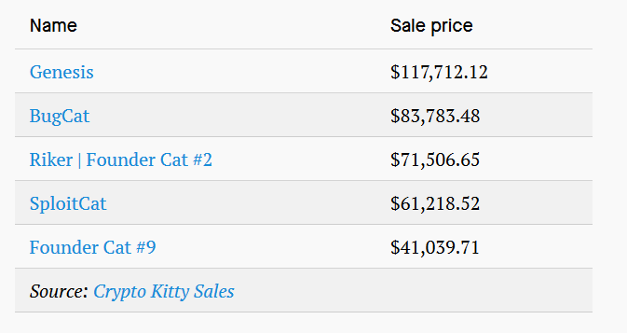
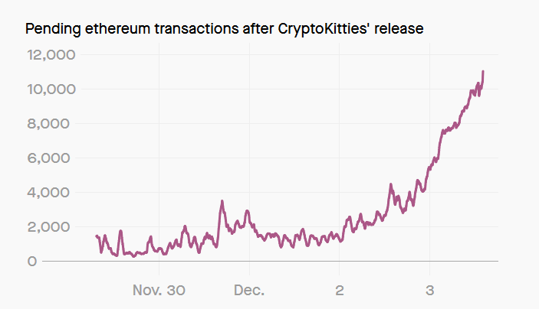
Strange Case of CryptoKitties

Slide 5
Why do we need Scalability Solutions?
Blockchain is a fairly complex technology and a mixture of lot of cutting edge distributed systems and cryptography theories and has been proven a good alternative to the traditional centralized Payment System. The vision of Blockchain can only be true when it achieve the scale of Transaction Per Second (TPS) of the traditional centralized systems such as VISA.
VISA is said to have a TPS of 47,000 and combined with other solutions it can way more up.
No blockchain platform is near the mark of TPS compared with VISA or similar solutions.
Currently, Blockchains (Rough Estimates) :
Bitcoin - 4 TPS
Ripple - 1500 TPS
Ethereum- 15 TPS

Slide 6
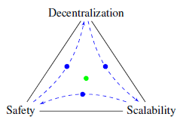
Blockchain Trilemma Problem
The problem of the TPS can easily be resolved by compromising one of the factors in the Blockchain Trilemma coined by Vitalik Buterin.
This states that a Blockchain can follow any two points at a time from - Safety, Scalability and Decentralization.
They can be Scalable but have to compromise of Safety or Decentralization.
At Most from the Three features only Two are achievable at a time.
If we take the example of Ripple that has the highest TPS among Bitcoin and Ethereum, it does a tradeoff in decentralization and is often debated as a near centralized solution.

Slide 7
Layers of Scalability
The scalability solution is widely divided into 3 layers:
Layer 0 Solutions – Network
Layer 1 Solutions – Blockchain Protocol
Layer 2 Solutions – Blockchain Offchain

Slide 8
Layer – 0 Scaling Solution
Layer 0 scaling solutions are solutions that work underneath a blockchain. They help content and block propagation across the network.
We could consider it Content Delivery Network (CDNs) for Blockchains. CDNs helped scaling the Internet for the masses, So is thought for the Layer 0 Scaling Solutions like bloXRoute, Marlin etc.
The Layer 0 Scaling solutions increases the scalability without modifying the architecture of the Blockchain.
It creates a Blockchain Distribution Network (BDN) which performs as high capacity, low latency global network that is specifically optimized to increase the speed of propagation of the Transactions and Blocks.

Slide 9
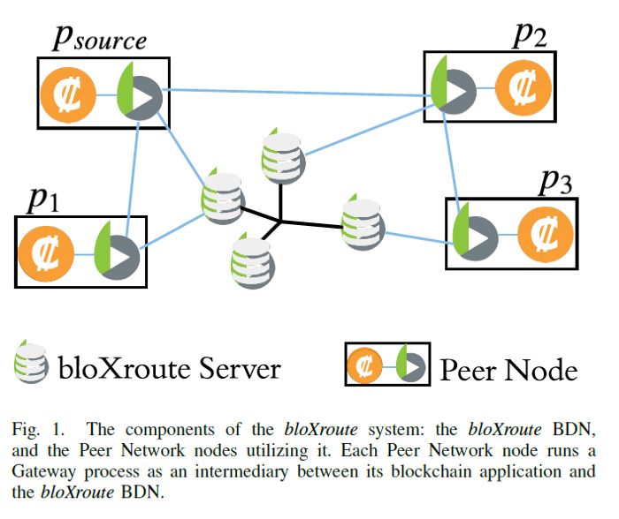
Layer – 0 Scaling Solution

Slide 10
Layer – 0 Scaling Solution
The magic of bloXroute is based on the fact that the BDN uses a small number of nodes to propagate blocks in a blockchain. The BDN blindly serves the nodes, without knowledge of the blocks it propagates, their origin, or their destination.
Additionally the nodes constantly serve as auditors of the behavior of the BDN.
The platform leverages system-wide caching that enables faster propagation and Gigabyte size blocks, and state-of-the-art routing methods that enable efficient transmission of blocks through the network.
While the protocol has no limits in the use cases, streaming and gaming dApps will be among the top gainers, as the Marlin solution offers dynamic traffic steering, forward error correction (FEC), and path conditioning functionalities.
These features, along with Proof-of-Availability and Proof-of-Bandwidth check make sure that the network is reliable and secure for data operations.
These protocols also have tokens to incentive people to acts as these P2P nodes and earn by doing so.

Slide 11
Layer – 1 Scaling Solution
Layer 1 Scaling solutions deals with the fundamental architecture of the Blokchain and would require significant amount of changes in the Protocol to make room for such kind of Scalability.
Sharding
Sharding is no new concept. We have this concept for decades in normal software development of databases.
The Approach is that we build a blockchain where every node doesn’t have to process every operation.
We split the entire state of the network into partitions called shards, that contain their own independent piece of state and transaction history. Also this Shards can have Sub-Shards. Every node only has to validate the transactions in his shard.
Now there are several “levels” of nodes that can exists, for example a Super-full node (fully downloads every collation of every shard), Top-level node, Single-shard node, Light node.

Slide 12
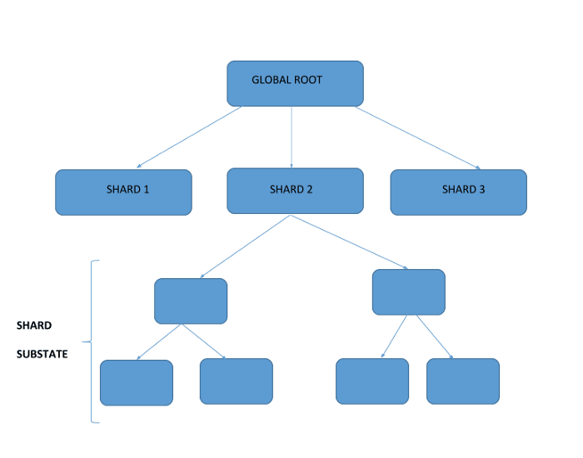
Layer – 1 Scaling Solution

Slide 13
I know what you feel…Is Blockchain useless right now?

Slide 14
Hold On! Layer 2 is Coming
Layer 2 are the Blockchain Solutions that Application Developers can use without depending upon the Protocol changes or the Network Routing.
These changes are dependent upon the Applications it is applied over.
We can choose not to use any of these changes altogether.
These changes should work without compromising the security of Blockchain or else they don’t make sense at all.
Some of the famous Layer 2 Scaling solutions are State Channels and Side Chains

Slide 15
State Channels
State channels refer to the process in which users transact with one another directly outside of the blockchain, or ‘off-chain,’ and greatly minimize their use of ‘on-chain’ operations.
It’s one of the most exciting Ethereum scaling solutions in development and the closest advancement to being production ready.
State channels are very similar to the concept of payment channels in Bitcoin’s Lightning Network, but instead of only supporting payments, they also support general ‘state updates.’
For example, votes conducted on the District Registry could be updated in a state channel and only broadcasted to the Ethereum network once all votes have been collected. This magnifies the number of computation developers can move off-chain.

Slide 16
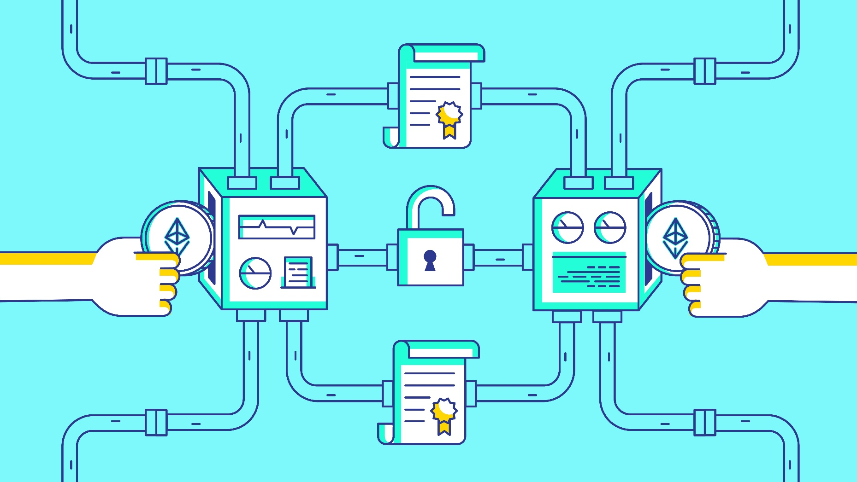
State Channels

Slide 17
Working of State Channels
State Channels sound great in theory, but they’re even more interesting when looking at them in practice. Here’s a brief example to illustrate how they functionally work:
Users lock up a portion of the state by sending money to a multisignature contract that has the ability to accept Ether and payout all parties who have sent it Ether.
Users sign transactions and send them to one another, each one making a copy of the signature for later reference.
Each transaction contains a nonce so the smart contract can know the chronological order of transactions.
Once both parties are done, they close the state by submitting a transaction to the Ethereum blockchain.
After the state is updated and unlocked, the smart contract sends each party their remaining Ether balance.

Slide 18
Side Chains and Plasma
Like Bitcoin Lightning Network, Plasma introduces the solution, or a method of processing off-chain transactions, while the security of these operations is provided by the “mother” blockchain, in case of Plasma technology the Ethereum blockchain.
Plasma allows creation of “child” blockchains, which are still connected with the “mother” blockchain.
These “child-chains” can also create their own “sun-child-chains”. Plasma and sidechains are in principle branches of several chains connected to their mother-chain.
The processing of smart contracts will work the same way as on the Etherum network with the exception that only the result is saved on the main chain, i.e. only the outcome is projected on the main chain. We can imagine it as a hierarchical structure of blockchain, periodically processing information back to the mother chain.

Slide 19
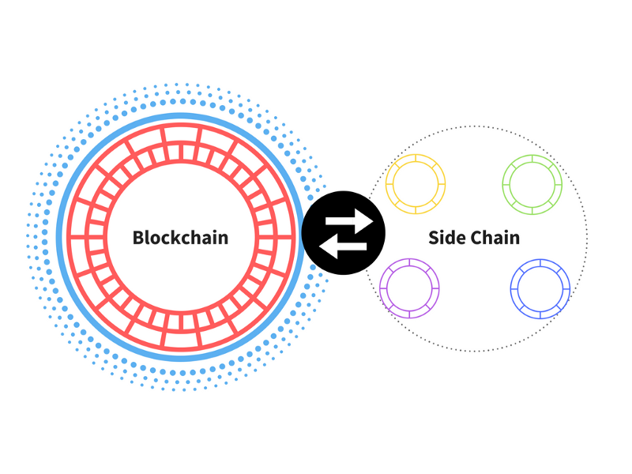
Side Chains and Plasma

Slide 20
Benefits of Plasma
Plasma helps Ethereum to process much bigger datasets that it is available to do now
Thanks to the vast increase of transaction capacity/throughput it allows applications with more complex operations to run on blockchain
Lower number of nodes processes only the transactions from sidechain, this leading to negligible per-transaction costs
Plasma will allow us to get rid of useless data, for now stored on the main chain. This will save a vast amount of energy and the memory capacity on the main-chain nodes.
Plasma is compatible with different on-chain scalability solutions such as sharding, different block sizes etc.

Slide 21
Benefits of Plasma
Plasma helps Ethereum to process much bigger datasets that it is available to do now
Thanks to the vast increase of transaction capacity/throughput it allows applications with more complex operations to run on blockchain
Lower number of nodes processes only the transactions from sidechain, this leading to negligible per-transaction costs
Plasma will allow us to get rid of useless data, for now stored on the main chain. This will save a vast amount of energy and the memory capacity on the main-chain nodes.
Plasma is compatible with different on-chain scalability solutions such as sharding, different block sizes etc.

Slide 22
Alrighty…Conclusion
There is going immense research in Scaling Blockchain to its best and last year there has been investment more than $20 Billion in projects that involved scalability.
Yeah, I know. Let’s start a Blockchain Scalability Startup but before doing that think how we would solve The Blockchain Trilemma.
Seeing the Development we can say that the Blockchain Scalability can be achieved in near future and it’s not just a fancy technology anymore but it’s not going to be easy.
Started Learning Blockchain and Got to know about Scalability Problem

